Slide 1


Oral Communication Skills B
(CELEN082)
Lesson 4.2

Slide 2
Lesson aims and objectives
Practise choosing relevant criteria to evaluate solutions. Practise evaluating solutions using specific criteria.

Slide 3

Getting started

Slide 4
Getting started
For homework, you watched the ‘problem’ section from the sample presentation entitled ‘Public Speaking Anxiety’.
What was the problem?
- Explanation
- Causes
- Impact
What solutions do you think could be used to solve / minimise the problem? Choose which one you think is the best.

Slide 5
Getting started
What was the problem?
Public speaking anxiety
before, during or after a presentation
impact can be physical, mental or behavioural
Causes
biological causes
brain response to perceived threat
PSA sufferers cannot control response
Impact
impact on students’ lives:
- module choices
- university participation
What solutions do you think could be used to solve / minimise the problem?

Slide 6
Evaluation criteria

Slide 7
Evaluation criteria
In Lesson 4.1 you looked at how to develop an effective solution, including an evaluation. Today we will focus more specifically on selecting and applying criteria for evaluating the solution.
What are three important aspects of an effective evaluation?
The evaluation should be based on criteria.
The evaluation should be balanced.
The evaluation should be supported with logic and / or evidence.

Slide 8
Evaluation criteria
Watch one solution provided by the experienced speaker on the problem of Public Speaking Anxiety.
What is the solution?
Virtual Reality exposure
How many criteria are used to evaluate the solution?
Two criteria
Which criteria are used to evaluate it?
Effectiveness and cost
How is the evaluation supported?
Effectiveness – supported with evidence from research
Cost – supported with logic and an example

Slide 9
Evaluation criteria
Evaluation criteria
For a short presentation, you should not choose too many criteria because you need to develop each one.
You should only select the most relevant and significant criteria.
You can support the evaluation with evidence from sources and / or using your own logic depending on the information you find when researching the topic.
Discuss.
Why do you think the presenter chose only two criteria to evaluate the solution?
Why do you think she chose effectiveness and cost as the two criteria?
Why do you think she supported one evaluation with evidence from research and the other evaluation with her own logic?

Slide 10
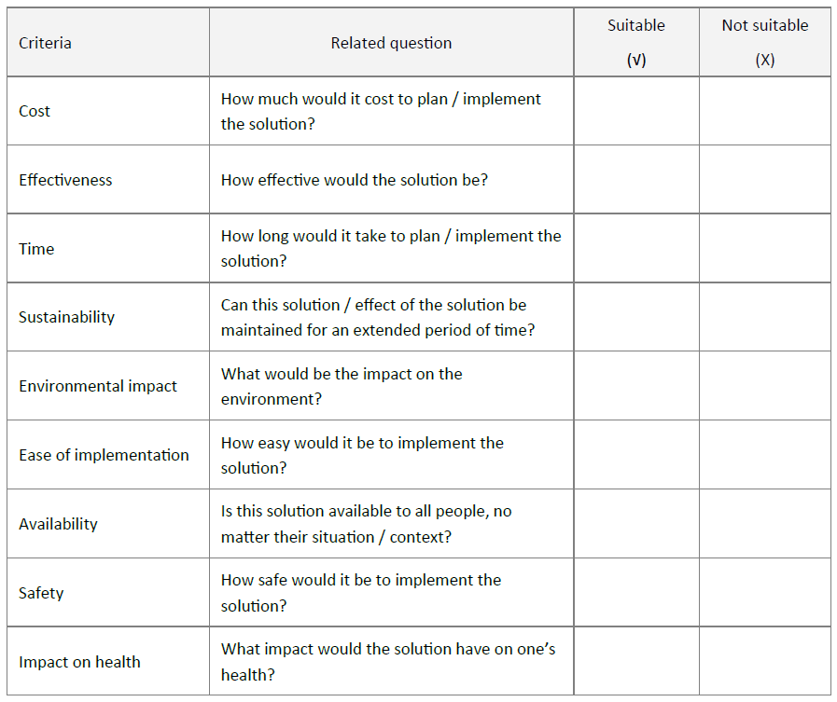

Evaluation criteria
You will now watch another solution to the problem of Public Speaking Anxiety, without the evaluation.
What is the solution?
Presentation Training Courses
Work with a partner. Decide which of the
criteria from the table could be used to
evaluate the solution.
Choose 2-3 criteria that could be used for
a balanced evaluation. Justify your choice.

Slide 11
Practice

Slide 12
Practice
Prepare a mini-presentation of the second sample solution, including your own evaluation.
The evaluation should be based on the 2-3 criteria you selected in the previous activity.
The evaluation should be balanced
The evaluation should be supported with your own logic (since you have not researched this solution).
When you’re ready, stand up and present your solution and evaluation to a partner.

Slide 13
Reminder
Due | Task
Lesson 5.1 | The Research Poster Event is assessed. Submit a copy of the poster to Moodle (as a .pdf document) before Lesson 5.1 (or there will be a 10% penalty on your score). Print your poster (size A3) and bring it to Lesson 5.1. Arrive on time. You will NOT be allowed to participate in the event (= fail the assessment), if … you don’t have a printed copy of the poster. you are late. If you are absent (without officially approved Extenuating Circumstances), you will fail the assessment. Try to predict the questions you might be asked and think about how you will answer them.

